Slide 1

Data Mining with R
For Internal Purposes Only
This presentation is solely for the use of client personnel. No part of it may be circulated, quoted or reproduced for distribution outside of the client organization without prior written approval of ZS Associates.
ZS Associates | 847.492.3600 | www.zsassociates.com

Slide 2
Agenda
Introduction
What is R, and why use it?
Basics of R and Rstudio
Data processing
Graphics
Modeling

Slide 3
R and Rstudio Installation
If needed, call ZS IT Helpdesk (x15555) for help
Install R
http://cran.rstudio.com/bin/windows/base/R-3.0.2-win.exe
Install RStudio Desktop IDE
http://download1.rstudio.org/RStudio-0.98.501.exe
Install R packages for today’s session
Type the following code at R or RStudio prompt:
install.packages(c("ggplot2", "plyr", "rpart", "arules", "arulesViz“), dependencies = TRUE)
library(ggplot2)
library(plyr)
library(rpart)
library(arules)
library(arulesViz)

Slide 4
Today’s session is designed to help you get started with R
The goal of this session is to help you get you started with R, by
Providing a high-level overview of R and its basics
Working on in-class activities to “get a feeling” of how R works
Exploring the use of resources and documentation
Discussing how R can be leveraged in your current work at ZS
Which of these topics should be emphasized today?
How to use R as a substitute for SAS?
Data loading
Data manipulation – rolling up, pivoting up/down, aggregation
How to write your own functions? How to create automated processes?
How to use graphics with R?
How to use R packages?
How to use R for modeling that cannot be done in SAS?

Slide 5
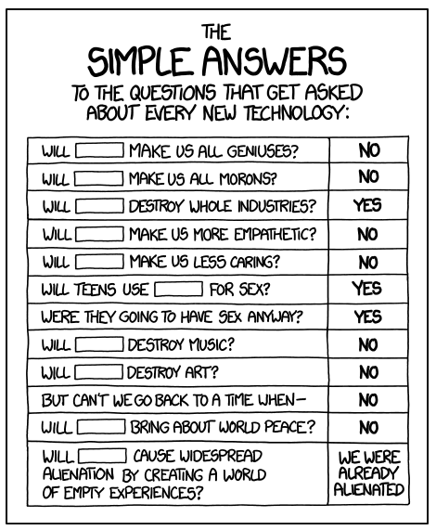
Caution: Usual rules of technology apply to R

Slide 6
Agenda
Introduction
What is R, and why use it?
Basics of R and Rstudio
Data processing
Graphics
Modeling

Slide 7








R is a complete tool for data manipulation, visualization, and modeling
What is R?
The power of R
R’s capabilities versus other tools
Data manipulation
Data visualization
Data modeling
Data manipulation
Data visualization
Predictive modeling
Optimization
User interface
Legend:
Low performing
High performing

Slide 8
There are several advantages of integrating R in your current workflow
What is R?
Unlike SAS, R is installed locally on your laptop at ZS
Pros
No Unix knowledge required
No transferring of files to/from Unix and hold drives
Cons
Data processing power limited to the size of RAM (2-3 GB)
Compliance with ZS data policies may require storage of data on project drives
R and Rstudio have an intuitive and easy-to-use interface
Saves time when writing and running code
Data processing and visualization from one screen – no need to switch back and forth between SAS and Excel
R and Rstudio are open source software
Free to use and update
Wide variety of packages/libraries created by a thriving open source community
Documentation and help readily available

Slide 9


With R, we can build and interpret models quickly in the same platform, speeding up the delivery of business analytics
What is R?
Old School
New School
Separation between modeling & interpretation slows down how quickly we can get to a viable solution
R allows us to combine modeling, interpretation, and visualization under one platform, speeding up analytics
Data Manipulation
Data Manipulation & Modeling
Modeling, Interpretation, & Visualization
Model Interpretation, Visualization, & Delivery
Delivery

Slide 10
Agenda
Introduction
What is R, and why use it?
Basics of R and Rstudio
Data processing
Graphics
Modeling

Slide 11
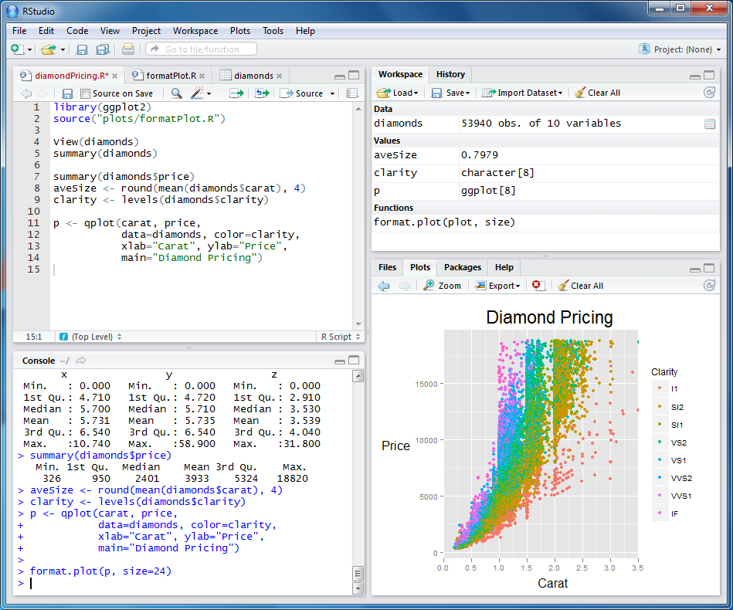
RStudio integrates variety of powerful coding tools to enhance productivity when working with data
R Basics
Source Editor
(Similar to VisualSlick on Unix)
Workspace & History
Inventory of current data, variables, functions etc
Plots, Packages, Help & Documentation
Console
Execution of R commands & scripts

Slide 12
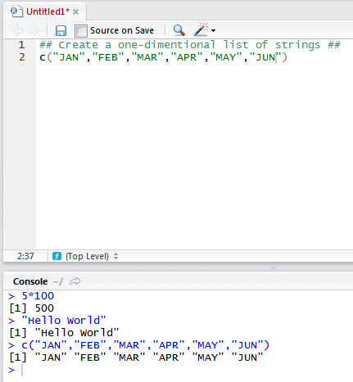
Writing and executing code with RStudio is quick and intuitive
R Basics
Execute entire script file (Ctrl + Alt + R)
Execute current line (Ctrl + Enter)
Execute selected lines (Ctrl + Enter)
Comment / Uncomment (Ctrl + Shift + C)
Indent line(s) (Ctrl + I)
Autocomplete code (Tab)
Collapse/Expand sections of code
Enter commands directly at the console

Slide 13
R Basics
R has a variety of data types in which you can store your data
Vectors
Indices start at 1
Matrices
All columns must have same mode (character, numeric, etc.)
Arrays
Matrices with >2 dimensions
Data Frames
Like matrix but columns can have different modes
Most similar to SAS dataset
Lists
An ordered collection of objects (literally anything)
Factors
Nominal/categorical variable ; a unique list of values
a <- c(1,2,4,5)
a[2]
2
A <- array(1:8,c(2,2,2))
A[,,2]
[,1] [,2]
[1,] 5 7
[2,] 6 8
L <- list(name=“Don”, age=23, pos=“Associate”,proj=c(“1234nj5678”,”8765nj4321”))
L[[“name”]]
Don
x <- matrix(1:20,nrow=4, ncol=5, byrow=TRUE)
x[2,]
[1] 6 7 8 9 10
J <- c(1,2,3,4)
K <- c(“A”, “B”, “C”, “D”)
L <- c(TRUE, FALSE, TRUE, TRUE)
df <- data.frame(J, K, L)
df$K
[1] A B C D
gender <- c(rep("male",20), rep("female", 30))
gender <- factor(gender)
summary(gender)
female male
30 20

Slide 14
Data frames can be filtered in various different ways
R Basics
We will use a sample dataset with daily climate data in New York city
dta <- airquality
Use “$” notation to extract individual columns of a data frame
What is the average of column titled Wind?
mean(dta$Wind)
Use “[ , ]” notation to extract specific rows and columns
Subset with only first two columns and all rows
dta[ , 1:2]
Subset with rows 5 through 20 and all columns
dta[5:20 , ]
Subset with first 50 rows and columns titled Month and Wind
dta[1:50 , c(“Month”,”Wind”) ]
Filtering based on data values
Data rows where Temperature is greater than 90
dta[dta$Temp>90 , ]
Data for the first 10 days of May
dta[dta$Month == 5 & dta$Day < 11,]

Slide 15
Practice
R Basics
Create a vector (on-dimention) named “x” with numbers from 1 through 1000
Create another vector named “y” where y = (X^2) – 2x
Create a dataframe named “d” which contains “x” and “y” as columns
Create a column “is.even” in “d” which uses TRUE/FALSE flag to flag even values of “y”
Hint: ifelse(<condition>,<value true>, <value false>)
Output the first 50 rows of dataframe “d”
Output the rows of data frame where y is odd

Slide 16
Agenda
Introduction
What is R, and why use it?
Basics of R and Rstudio
Data processing
Graphics
Modeling

Slide 17
Functions are the workhorses of data processing in R
Data Processing in R
Functions take argument(s) (optional), perform some operation, and return an output
Functions in R are similar to routines in VB or macros in SAS
Users can define their own functions or use pre-defined functions in R
Defining Function:
myfunction <- function(arg1, arg2, ... ){ statements return(object) }
Example:
c.to.f <- function(c.temp) {
f.temp <- (c.temp*9/5) + 32
return(f.temp)
}
Invoking Functions:
c.to.f(25)
c.temps <- c(-10,0,10,20,30,40,50)
c.to.f(c.temps)

Slide 18
R comes with wide variety of library functions
Data Processing in R
Examples of pre-built functions in R
Read or write data from text files
inpds <- read.csv(“input_file.csv”,header=TRUE)
write.csv(outpds,”output_data.txt”)
Create scatter plot
library(ggplot2)
x <- c(1:100)
y1 <- x*(x-50)
qplot(x,y1)
Create a box plot
boxplot(y1)
Merge two data sets
output <- merge(input1, input2, by.x = col1)

Slide 19
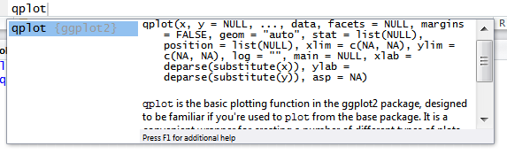

Finding and using new functions is easy
Data Processing in R
Finding help on how to use functions
Use Auto-complete feature when writing code
Use help() or ? Commands
Search box on “Help” tab
R documentation on the web
Finding new functions
Google / Stack Overflow searches
Package documentation from the “Package” Tab
Hitting <Tab> after function name invokes documentation
help() and ? also invoke documentation

Slide 20
Practice
Data Processing in R
Load a dataset named “diamonds” from package “ggplot2”
Create a function called “rock.finder”
Accepts value for cut, color, clarity and
Returns the number of diamonds from “diamonds” with matching criteria
Returns error message if one of criteria entered by users is invalid
Using “rock.finder”, how many diamonds of “Ideal” cut, “J” color, and “IF” clarity are available
Create a summary (zslist) of count of diamonds by their cut
Create a crosstab of count of diamonds by their cut vs. clarity
Create a summary (zslist) of diamonds by cut with count, average price, max price, and min price

Slide 21
Now we will review how to do some common data processing procedures in R
Data Processing in R
Reading and writing data
Sub-setting and selecting
Merging
Sorting
De-duplicating
Summarizing at different levels
Concatenating
Data type conversion
Adding fields
Ranking
Job-runs and scripts
Normalizing and de-normalizing data

Slide 22
Importing and exporting data in R is a breeze
Data Processing in R
inds1 <- read.csv(
“input_sales.txt”,
header = TRUE,
colClasses = c(“character”, “numeric”, “factor”)
)
outds <- write.csv(
outds,
“output_sales.txt”
)
<- is the assignment operator in R
read.csv(…) pulls data into a data.frame!
We’ll cover conversion between different data types later…
read.csv(…)/write.csv(…)
are identical to read.table(…)/write.table(…) except for defaults params

Slide 23
The best way to subset data.frames is to use which and/or %in%
Data Processing in R
output_df1 and output_df2 are identical!
output_df1 <- input_df[which(!(input_df$state == “MA” | input_df$state == “NH”)),]
output_df2 <- input_df[which(!(input_df$state %in% c(“MA”, “NH”))),]
output_df1 <- input_df[,c(“id”, “name”, “state”)]
output_df1 <- input_df[,!(names(output_df1) %in% c(“state”))]
[df]$[field] is used to select a specific column in a data frame
“|” and “&” are the “AND” and “OR” logical operators respectively
The which function returns a vector of TRUEs and FALSEs; not actually necessary…
X %in% Y returns a vector of TRUEs/FALSEs of length(X)

Slide 24
The merge function can be used to merge two (but only two) data.frames
Data Processing in R
Type of Join | R Code | SAS Code
Inner Join | output <- merge(input1, input2, by.x = c(“a”, “b”), by.y = c(“c”, “d”), all = FALSE) | DATA output; MERGE input1 (IN = in1) input2 (IN = in2 RENAME = (c = a d = b)); BY a b; IF (in1 AND in2); RUN;
Outer Join | output <- merge(input1, input2, by.x = c(“a”, “b”), by.y = c(“c”, “d”), all = TRUE) | DATA output; MERGE input1 (IN = in1) input2 (IN = in2 RENAME = (c = a d = b)); BY a b; IF (in1 OR in2); RUN;
Left Join | input1$in1 <- 1 input2$in2 <- 1 output <- merge(input1, input2, by.x = c(“a”, “b”), by.y = c(“c”, “d”), all = TRUE) output <- output[which(!is.na(output$in1)),] | DATA output; MERGE input1 (IN = in1) input2 (IN = in2 RENAME = (c = a d = b)); BY a b; IF (in1); RUN;
Merging >2 data.frames requires multiple merge statements in R, unlike SAS

Slide 25
Sorting and de-duplicating data.frames in R is similar to sorting and de-duplicating datasets in SAS
Data Processing in R
output <- input[order(input$a, input$b), ]
output <- input[!duplicated(input[, c(“a”, “b”)]), ]
An unlimited number of equally sized vectors can be included in the order function
You do not need to sort data.frames before merging, unlike SAS
The parameter of the duplicated function is one vector or a data.frame, not a series of vectors

Slide 26
The table and tapply functions are more flexible than %ZSLIST because any function can be applied
Data Processing in R
> input <- data.frame(a = rep(1:3, 2), b = 6:1)
> as.data.frame(table(input$a))
Var1 Freq
1 1 2
2 2 2
3 3 2
> output <- as.data.frame(as.table(tapply(input$b, input$a, mean)))
> output
Var1 Freq
1 1 4.5
2 2 3.5
3 3 2.5
> is.factor(output$Var1)
[1] TRUE
The table function is almost identical to the %ZSLIST macro
The index vector (input$a) is converted into a factor in the output
Any function accepting a vector as the param can be put here

Slide 27
The rbind and cbind functions can be used to concatenate data.frames by rows and columns
Data Processing in R
> output <- rbind(input1, input2)
> output <- cbind(input1, input2)
rbind and cbind require that the inputs have an equal number of columns and rows respectively
However, rbind.fill and cbind.fill in the plyr package will populate missing values with NAs

Slide 28
as.character and as.numeric are used for data type conversion
Data Processing in R
> output <- as.data.frame(as.table(tapply(input$b, input$a, mean)))
> output
Var1 Freq
1 1 4.5
2 2 3.5
3 3 2.5
> max(output$Var1)
Error in Summary.factor(1:3, na.rm = FALSE) :
max not meaningful for factors
> max(as.numeric(as.character(output$Var1)))
[1] 3
Convert to character and then to numeric for factors to avoid getting numeric factor levels

Slide 29
unsplit, spit, and rank can be used together to create a rank a variable at different levels
Data Processing in R
stop_times <- stop_times[!duplicated(stop_times[,c("trip_id", "stop_id")]),]
tripfactor <- as.factor(stop_times$trip_id)
stop_times <- unsplit(lapply(
split(stop_times, tripfactor),
function(x) cbind(x[,!(names(x) %in% c("stop_sequence"))], "stop_sequence" = rank(x$arrival_time))
), tripfactor)
lapply is similar to sapply and mapply except it applies a function over a list rather than a vector
split creates a list of data.frames, one for each factor level; unsplit does the opposite
Unlike tapply/table, the level of the dataset is unchanged here

Slide 30
source and sink can be used to simulate the jobrun environment in R
Data Processing in R
outdf <- "jobrun"
sink(paste(outdf, ".txt", sep = ""))
processes <- c(“script1.R”, “script2.R”, “script3.R”)
time_sec2str = function(s){
temp <- s%%(60 * 60)
h <- (s - temp)/(60 * 60)
h <- ifelse(h < 10, paste("0", h, sep = ""), as.character(h))
s <- temp
temp <- s%%60
m <- (s - temp)/60
m <- ifelse(m < 10, paste("0", m, sep = ""), as.character(m))
s <- round(temp)
s <- ifelse(s < 10, paste("0", s, sep = ""), as.character(s))
paste(h, m, s, sep = ":")
}
total_elapsed <- 0
for (process in processes){
print(paste(process, ":", sep = ""))
elapsed <- system.time(source(process))["elapsed"]
print(time_sec2str(elapsed))
total_elapsed <- total_elapsed + elapsed
gc() # garbage collection
}
print("total time elapsed:")
print(time_sec2str(total_elapsed))
sink(file = NULL)
sink diverts output to a .txt file
source(“file.R”) runs a script
Inside a script, need to use print function to display things

Slide 31
The reshape package is easily accomplished with the reshape package
Data Processing in R
> library(reshape2)
> people <- data.frame(person_id=1:4, name=c("Don", "Dan", "Nick", "Tom"), age=c(23, 24, 85, 16))
> people_norm <- melt(people, id.vars="person_id")
> people_norm
person_id variable value
1 1 name 2
2 2 name 1
3 3 name 3
4 4 name 4
5 1 age 23
6 2 age 24
7 3 age 85
8 4 age 16
> people_norm$person_id <- sapply(people_norm$person_id, function(x) paste("person", x, sep = ""))
> names(people_norm) <- c("variable", "id", "value")
> dcast(people_norm, id ~ variable)
id person1 person2 person3 person4
1 name 2 1 3 4
2 age 23 24 85 16
The cast and melt functions can be used to normalize and de-normalize data respectively
paste is used to concatenate characters in R
Cast formula is of form:
x₁ + … + x_{n} ~ y₁ + … + y_{n}
More details in http://cran.r-project.org/web/packages/reshape2/reshape2.pdf

Slide 32
Agenda
Introduction
What is R, and why use it?
Basics of R and Rstudio
Data processing
Graphics
Modeling

Slide 33
ggplot2 package provides a way to generate graphics quickly
Graphics with R
Grammar of Graphics refers to construction of data-driven graphics by combining multiple components and layers in an effort to move beyond named graphics (“scatter plot”)
ggplot2 package implements the Grammar of Graphics ideas in R
Advantages of using ggplot2 include:
Builds graphics from ground up
Mirrors how we think of building plots and analyzing data
Default options for spacing, color, margins that can be modified by users (similar to Excel)
Complex plots including multiple types and grids
Documentation for ggplot2 can be found at: http://docs.ggplot2.org/current/

Slide 34
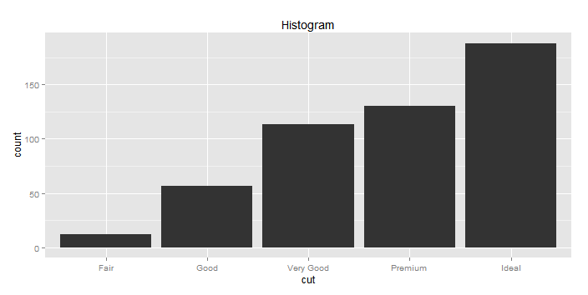
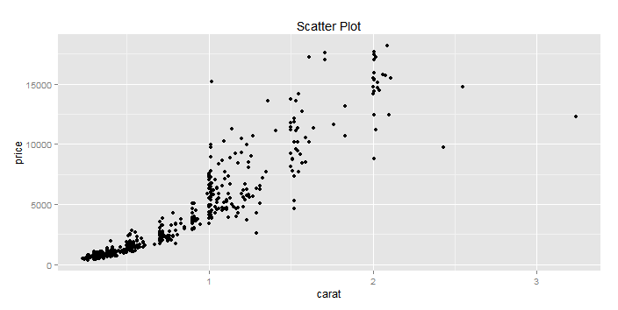
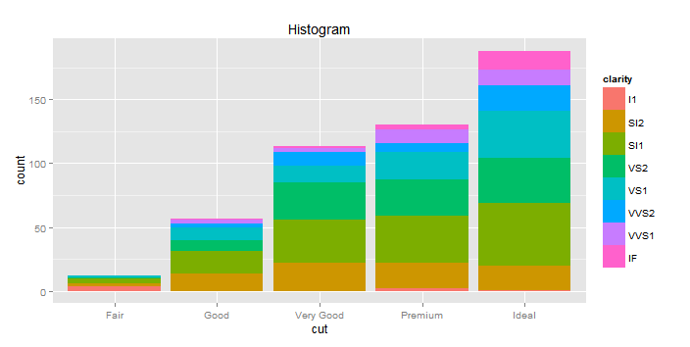
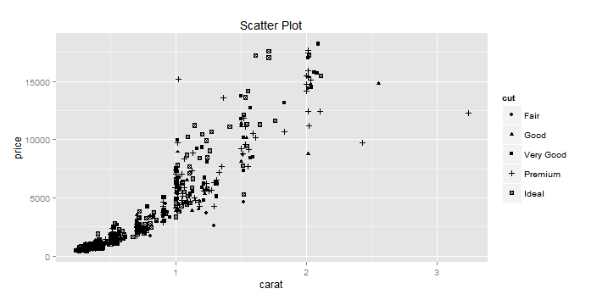
qplot function can be used to create most traditional graphs
Graphics with R
Qplot works with one (x) or two (x and y) variables
Data on the plot can be cut by other variables using color, shape and size
qplot(data = d, x = cut)
qplot(data = d, x = carat, y = price)
qplot(data = d, x = cut, fill = clarity)
qplot(data = d, x = carat, y = price, shape=cut)

Slide 35
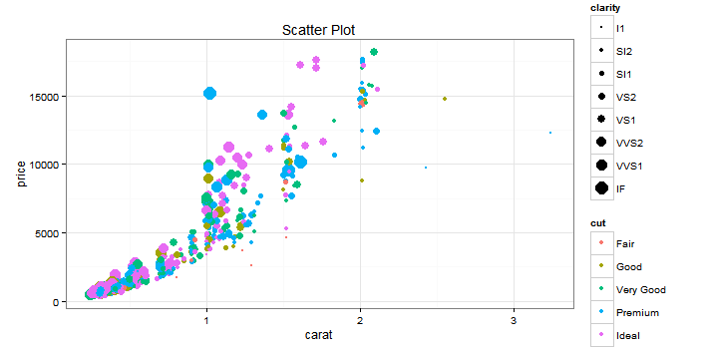
Complex, multi-variable plots can be easily create with qqplot
Graphics with R
qplot(x = carat, y = price, data = d, color = cut, size = clarity)

Slide 36
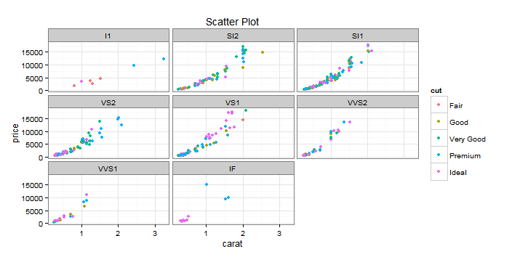
You can also create facets to generate multiple plots
Graphics with R
qplot(x = carat, y = price, data = d, color = cut, facets = ~clarity)

Slide 37
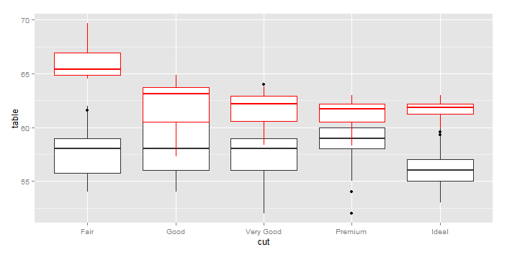
ggplot is similar to qplot but allows more layering and complexity
Graphics with R
p1 <- ggplot (data=d, aes(x=cut))
p1 + geom_boxplot( aes(y = table)) + geom_boxplot( aes(y = depth), color = "red")

Slide 38
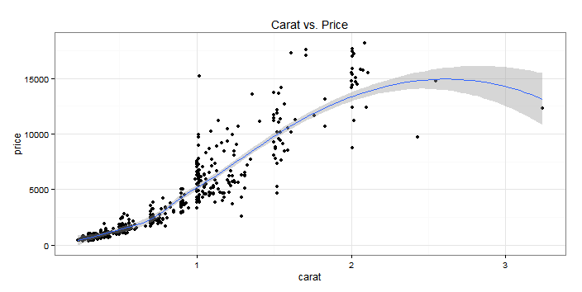
Ggplot() is similar to qplot() but allows more layering and complexity
Graphics with R
p1 <- ggplot(data=d,aes(x=carat,y=price))
p1 + geom_point() + geom_smooth() + labs(title="Carat vs. Price")

Slide 39
Practice
Graphics with R
Create a histogram of price distribution of diamonds
Using the diamond dataset, create a bar plot of cut (stacked by clarity) vs. average price
Create a stacked (normalized to 100%) bar chart of diamond count by cut and clarity
Apply ZS colors to above chart
c("#688A92","#506772","#00694A","#FF7D00","#076AB5","#BF9761","#9D9E9C","#A41128")
Create following scatter plots
Carat vs. Price with a linear trendline and equation
Carat vs. Price with a different color (ZS color) for each type of cut
Previous chart separate for each combination of color and clarity

Slide 40
Agenda
Introduction
What is R, and why use it?
Basics of R and Rstudio
Data processing
Graphics
Modeling

Slide 41
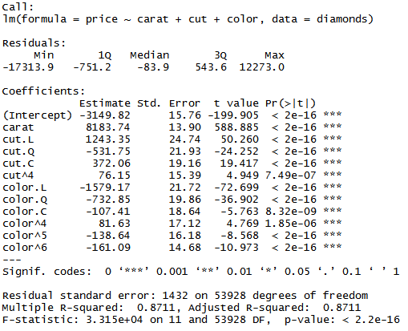

Linear regression can be done using lm() function in R
Modeling with R
lm function fits a specified linear model (including categorical variable)
summary summarizes the fit results

Slide 42
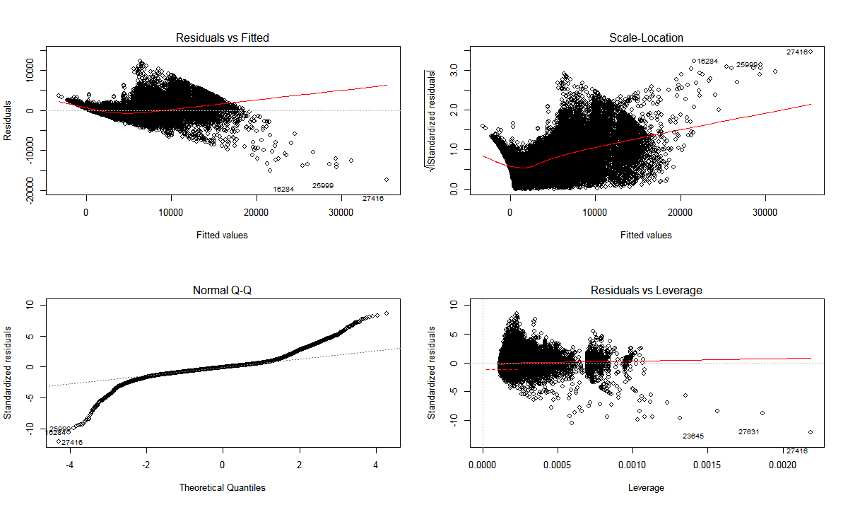
Plot() can be used to generate diagnostic plots for the fit
Modeling with R
plot(fit)

Slide 43
Several other supporting functions provide a deeper dive into the model
Modeling with R
Model coefficients
coefficients(fit)
Confidence Intervals for coefficients
confint(fit, level=0.95)
Predicted values
fitted(fit)
Residuals
residuals(fit)
ANOVA table
anova(fit)
Covariance matrix for model parameters
vcov(fit)

Slide 44
Other useful packages for modeling in R
Modeling with R
Tree-based (CART) models – rpart
Model-based clusters – mclust
Time-series – zoo and xts
…

Slide 45
That’s it! Spread the word!

Slide 46
APPENDIX

Slide 47
…but R is not the best tool for everything
What is R?
When to use R
When to use Excel
When to use SAS
Data exploration
Heavy data manipulation
Designing durable processes
Newer types of predictive modeling
Nice presentation
Quick and dirty number crunching
Simple optimization (e.g. Solver)
Models for clients
Big data
Heavy data manipulation
Designing durable processes
Multi-user process development

Slide 48
What types of projects have I used R for?
 | Assess both potential and receptivity of customers Develop receptivity scores for customers based on demonstrated behavior
 | Segment customers based on their attitudes and behaviors Segments have varying brand potential and different messaging implications
 | Assess demand for product in different scenarios (product attributes, patient subpopulations, etc.) Understand how behaviors change as a result of market events
 | Understand how differences in a product’s underlying attributes impact it usage in the marketplace Common approach for products still in clinical trials
 | Identifiers influences of physician behavior Identify/validate academic KOLs as well as clinical KOLs
Targeting
Segmentation
Demand Estimation/Forecast
Conjoint
Influence Mapping

Slide 49
Basic toolkit
R Basics
Function | Syntax | What it does
READ.CSV | mydata <- read.csv( file = "mydata.csv", stringsAsFactors = FALSE, header = TRUE, sep = “,”) | Read to CSV
WRITE.CSV | write.csv( mydata, file = “mydata_out.csv”, row.names = FALSE, na = NA) | Write to CSV
APPLY | apply(data, c(1, 2), function(x) … ) | Apply function over rows and/or columns
TABLE | table(data$field1, data$field2) | Count across levels (ZSLIST)
DIM / LENGTH | dim(data)/length(vector) | Size/length
MERGE | merge(x, y, by = c(…), all.x = TRUE) | Merge
ARRANGE | arrange(mydata, age) | Sort
SUBSET | subset(mydata, age <= 50, select = c(“full_name”, “age”)) | Filter rows and/or columns
MUTATE | mydata <- mutate(mydata, full_name = paste(first_name, last_name), age = 2013 – dob) | Add variables as function of existing variables
HELP | help(merge) | View documentation for a function

Slide 50
The plyr package implements the split-apply-combine framework, which is used for data transformations
R Basics
The split-apply-combine framework
Split up a big dataset
Apply a function to each piece
Combine all the pieces back together
Data
Piece
Piece
Data
Piece
Piece
Split
Apply Function to Each Piece
Combine
Piece
Piece
Piece
Piece
Piece
Piece
Piece
Piece
This framework can be used to reduce the level of the data (e.g. aggregate to a certain level) or simply transform the data without changing its level (e.g. rank a field within a level)

Slide 51
The ddply function is the workhorse of the plyr package
R Basics
The split-apply-combine framework
Split up a big dataset
Apply a function to each piece
Combine all the pieces back together
ddply from plyr package
Input
How to split up
Function to apply to each piece
# Split
pieces <- split(mydata, list(mydata$bucket))
# Apply
results <- vector("list", length(pieces))
for(i in seq_along(pieces)) {
piece <- pieces[[i]]
piece <- transform(piece,
rank = rank(-rankvar, ties.method = "first"))
results[[i]] <- piece
}
# Combine
result <- do.call("rbind", results)
# Or equivalently
mydata <- ddply(mydata, c(“bucket"), transform,
rank = rank(-rankvar,
ties.method = "first"))
2nd argument to transform
Use “transform” when the level of the data is not changing (e.g. rank, cumulative sum)
Use “summarise” if reducing data to smaller level (e.g. sum, min, max)

Slide 52
The reshape package assists with normalization and de-normalization transformations
R Basics
Melt & Cast
Melt
norm <- melt(sales, id = c(“Id”))
Id | Time | Sales
A | Sales Today | 10
A | Sales Yesterday | 8
A | Sales Two Days Ago | 7
B | Sales Today | 20
B | Sales Yesterday | 40
B | Sales Two Days Ago | 42
C | Sales Today | 3
C | Sales Yesterday | 19
C | Sales Two Days Ago | 8
De-normalized
Id | Sales Today | Sales Yesterday | Sales Two Days Ago
A | 10 | 8 | 7
B | 20 | 40 | 42
C | 3 | 19 | 8
Normalized
denorm <- cast(norm, id ~ time, value = “sales”, fun.aggregate = “sum”)
Cast

Slide 53
Agenda
What is R, and what can we use it for?
The basics
Data manipulation and visualization
Case study: Baby names
Predictive modeling
Case study: Surviving the Titanic

Slide 54
Case Study: Baby Names
Baby Names
Baby Names Dataset
Top 1000 male and female baby names in the U.S. from 1880 to 2008
1000 names * 2 genders * 129 years = 258,000 records
Only 4 variables: year, name, sex, percent of names
> head(bnames, 10)
year name percent sex
1 1880 John 0.081541 boy
2 1880 William 0.080511 boy
3 1880 James 0.050057 boy
4 1880 Charles 0.045167 boy
5 1880 George 0.043292 boy
6 1880 Frank 0.027380 boy
7 1880 Joseph 0.022229 boy
8 1880 Thomas 0.021401 boy
9 1880 Henry 0.020641 boy
10 1880 Robert 0.020404 boy
> tail(bnames, 10)
year name percent sex
257991 2008 Jamiya 0.000129 girl
257992 2008 Kathy 0.000129 girl
257993 2008 Laylah 0.000129 girl
257994 2008 Riya 0.000129 girl
257995 2008 Diya 0.000128 girl
257996 2008 Carleigh 0.000128 girl
257997 2008 Iyana 0.000128 girl
257998 2008 Kenley 0.000127 girl
257999 2008 Sloane 0.000127 girl
258000 2008 Elianna 0.000127 girl

Slide 55
Case Study: Baby Names Summarizing the data
Baby Names
Summaries
Create a summaries for the following:
% of name that is vowels
Name length
First letter of name
Last letter of name
How has name popularity, by first letter, over time changed?
How has the % of people having top 100 names changed over time?
Investigate how the popularity of top 20 names has changed over time

Slide 56
Case Study: Baby Names Some quick summaries
Baby Names
Make some useful functions & apply
Make some summaries
letter <- function(x, n = 1) {
if (n < 0) {
nc <- nchar(x)
n <- nc + n + 1
}
tolower(substr(x, n, n))
}
vowels <- function(x) {
nchar(gsub("[^aeiouAEIOU]", "", x)) /
nchar(x)
}
bnames <- mutate(bnames,
first = letter(name, 1),
last = letter(name, -1),
length = nchar(name),
vowels = vowels(name)
)
ddply(bnames, c("first"), summarise,
tot = sum(percent) /
sum(bnames$percent))
ddply(bnames, c("last"), summarise,
tot = sum(percent) /
sum(bnames$percent))
with(bnames,
sum(length * percent) / sum(percent))
temp <- bnames[!duplicated(bnames$name),]
head(arrange(temp, -length))
head(arrange(temp, vowels))
head(arrange(temp, -vowels))
~6
Regular expressions!
Bartholomew!
Lynn, Byrd!
Louie!

Slide 57
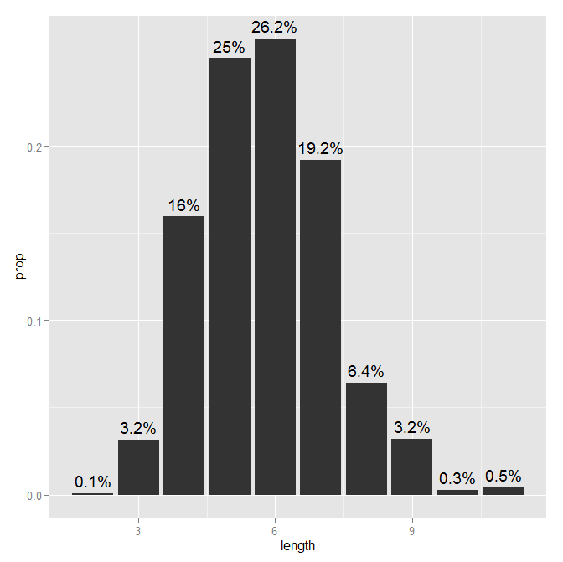
Case Study: Baby Names Summary of name length
Baby Names
Summary of name length
temp <- ddply(bnames, c("length"), summarise,
prop = sum(percent) / sum(bnames$percent))
windows()
ggplot(temp, aes(
x = length,
y = prop)) +
geom_bar(stat = "identity") +
geom_text(aes(
label = paste(round(prop * 100, 1), "%", sep = "")
), vjust = -0.5)

Slide 58
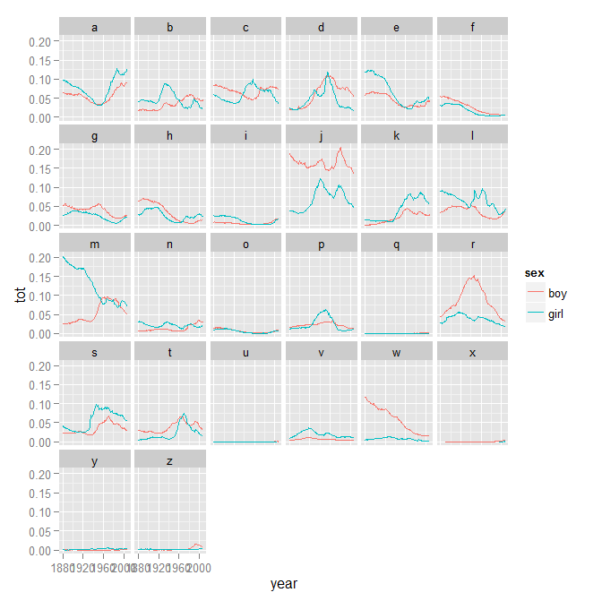
Case Study: Baby Names Summary of name popularity over time by first letter
Baby Names
Summary of name popularity over time by first letter
fl <- ddply(bnames,
c("year", "sex", "first"),
summarise, tot = sum(percent))
windows()
ggplot(fl) +
geom_line(aes(
x = year,
y = tot,
colour = sex)) +
facet_wrap(~ first, ncol = 6)

Slide 59
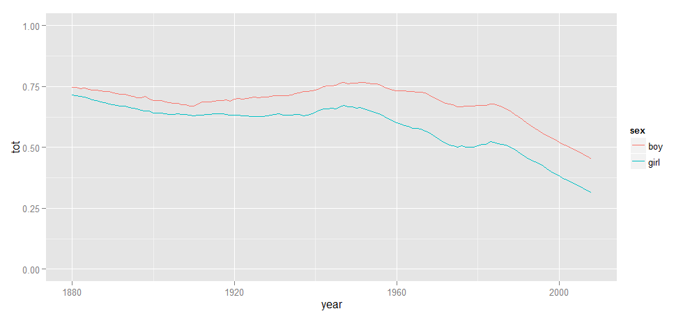
Case Study: Baby Names Popularity of “common” names over time
Baby Names
Proportion of people with top 100 names over time
bnames <- arrange(bnames, year, sex, -percent)
bnames$count <- 1
top100 <- ddply(bnames, c("year", "sex"), transform, count = cumsum(count))
top100 <- subset(top100, count <= 100)
top100 <- ddply(top100, c("year", "sex"), summarise, tot = sum(percent))
ggplot(top100)+geom_line(aes(x = year, y = tot, group = sex, colour = sex))+scale_y_continuous(limits = c(0, 1))
“Donald” still not top 100 though…

Slide 60
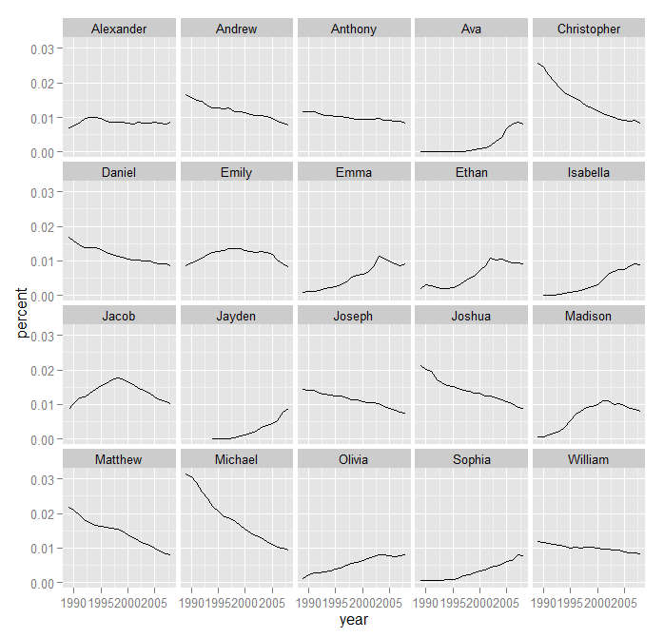
Case Study: Baby Names Most popular names of 2008 over the last 20 years
Baby Names
Most popular names of 2008 over the last 20 years
top20 <- head(arrange(subset(bnames,
year == 2008), -percent)$name, 20)
top20 <- subset(bnames,
name %in% top20 &
year >= 1989)
top20 <- ddply(top20,
c("year", "name"), summarise,
percent = sum(percent))
windows()
ggplot(top20) +
geom_line(aes(
x = year,
y = percent)) +
facet_wrap(~ name, ncol = 5)
Twilight!

Slide 61
Agenda
What is R, and what can we use it for?
The basics
Data manipulation and visualization
Case study: Baby names
Predictive modeling
Case study: Surviving the Titanic

Slide 62
Case Study: Surviving the Titanic
Titanic
Titanic Survivor Dataset
From Kaggle (site that hosts data mining competitions; good source of public data!)
Have data on 891 passengers and whether or not they survived (hint: not Leo)
> head(titanic)
PassengerId Survived Pclass Name Sex Age SibSp Parch Ticket Fare Cabin Embarked
1 1 0 3 Braund, Mr. Owen Harris male 22 1 0 A/5 21171 7.2500 S
2 2 1 1 Cumings, Mrs. John Bradley (Florence Briggs Thayer) female 38 1 0 PC 17599 71.2833 C85 C
3 3 1 3 Heikkinen, Miss. Laina female 26 0 0 STON/O2. 3101282 7.9250 S
4 4 1 1 Futrelle, Mrs. Jacques Heath (Lily May Peel) female 35 1 0 113803 53.1000 C123 S
5 5 0 3 Allen, Mr. William Henry male 35 0 0 373450 8.0500 S
6 6 0 3 Moran, Mr. James male 28 0 0 330877 8.4583 Q
Survival: Survival (0 = No; 1 = Yes)
Pclass: Passenger Class (1 = 1st; 2 = 2nd; 3 = 3rd)
Name: Name
Sex: Sex
Age: Age
Sibsp: Number of Siblings/Spouses Aboard
Parch: Number of Parents/Children Aboard
Ticket: Ticket Number
Fare: Passenger Fare
Cabin: Cabin
Embarked: Port of Embarkation (C = Cherbourg; Q = Queenstown; S = Southampton)

Slide 63
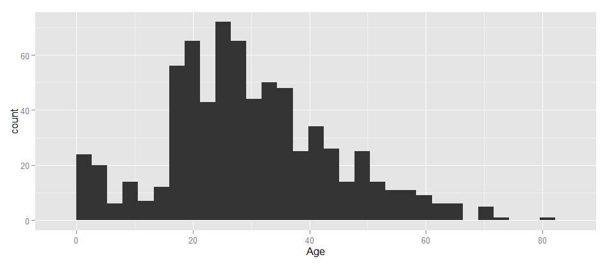
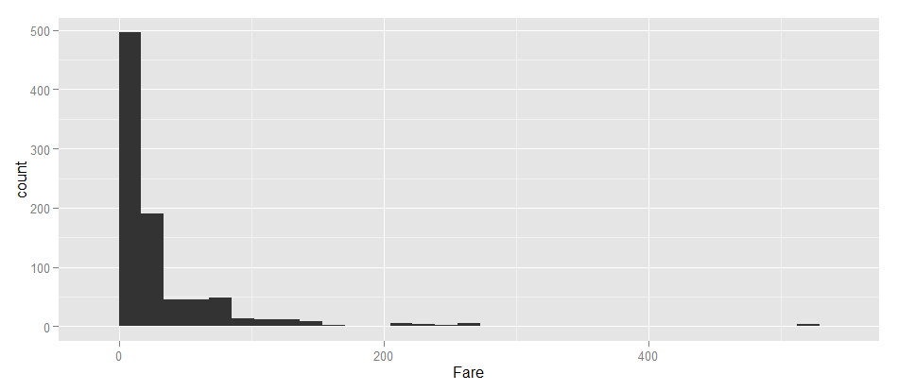
Case Study: Surviving the Titanic Building some predictive models
Titanic
Titanic Survivor Dataset
table(titanic$Survived) # numeric
table(titanic$Pclass) # numeric
table(titanic$Sex) # factor
table(titanic$Embarked) # factor
table(titanic$SibSp) # numeric
table(titanic$Parch) # numeric
windows()
ggplot(titanic) + geom_histogram(aes(x = Age))
windows()
ggplot(titanic) + geom_histogram(aes(x = Fare))
head(arrange(titanic, -Fare))
70% of passengers with top 10 fares survived. Overall survival rate = 38%

Slide 64
Case Study: Surviving the Titanic Predictive model options
Titanic
Predictive Modeling Golden Rules
Cross-validation to prevent overfitting
Sample ≠ Universe: you can’t reliably predict based on inputs you haven’t seen before
“Regression to the mean”
Try lots of approaches
Approach | Pros | Cons
Regression (glmnet) | Simple to understand | Assumes linearity Difficult to handle variable dependencies
Decision Trees (CART) | Handles dependencies well Very logical | Lack of granularity May not capture all of the nuansce of the data
Ensemble Classifiers (RandomForest) | Don’t overfit Very good predictability Good for assessing variable “importance” | “Black box” Difficult to transfer to other platforms (but not impossible)
Frequent Item Sets (apriori) | Output is a simple set of rules | Requires categorical variables
Our focus

Slide 65
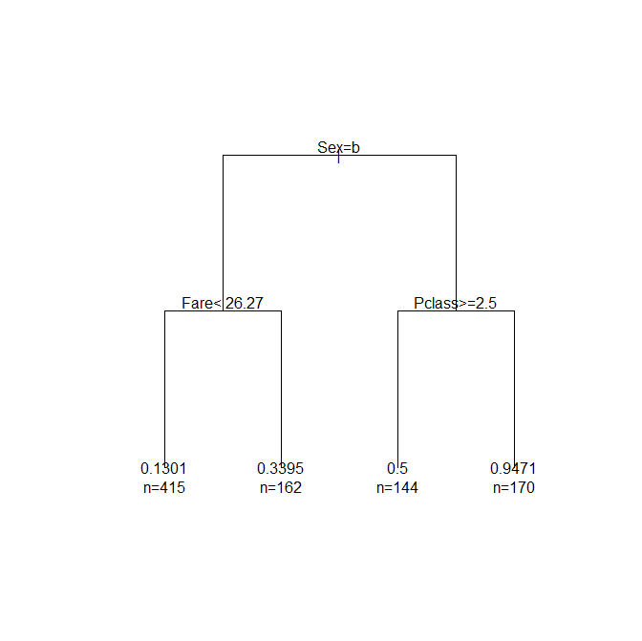
Case Study: Surviving the Titanic Simple decision tree
Titanic
Simple decision tree using rpart package
single.tree <- rpart(
Survived ~ .,
titanic[,c("Survived", "Pclass", "Sex", "Embarked", "SibSp", "Parch", "Age", "Fare", "miss", "mrs")],
control = rpart.control(
minbucket = 50))
single.tree <- prune(single.tree,
cp = single.tree$cptable[
which.min(single.tree$cptable[,"xerror"]), "CP"])
windows()
plot(single.tree, uniform = TRUE,
margin = 0.2)
text(single.tree, use.n = TRUE)
Male
Female

Slide 66
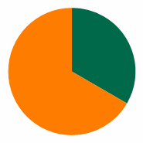
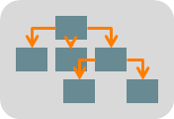
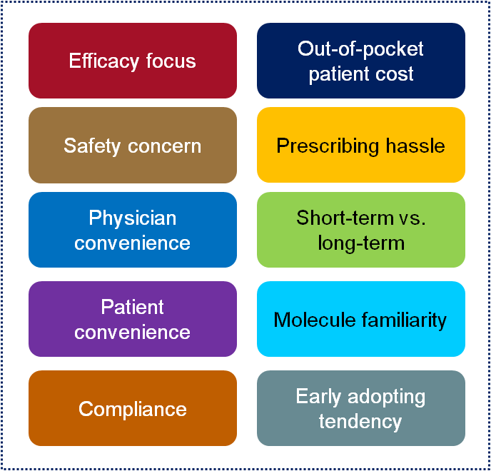
Case Study: Surviving the Titanic How Random Forest works
Titanic
Random Forest
Bootstrapping: each decision tree is built on a random 2/3 of the sample to avoid overfitting
Predictors
Decision Tree
Each tree is made with a random subset of predictors
Uses CHAID/CART-like procedure to determine cut points that maximize differentiation in objective variable
Prediction
Each tree gets a vote. Sum up all the votes. It’s basically just a democracy.

Slide 67
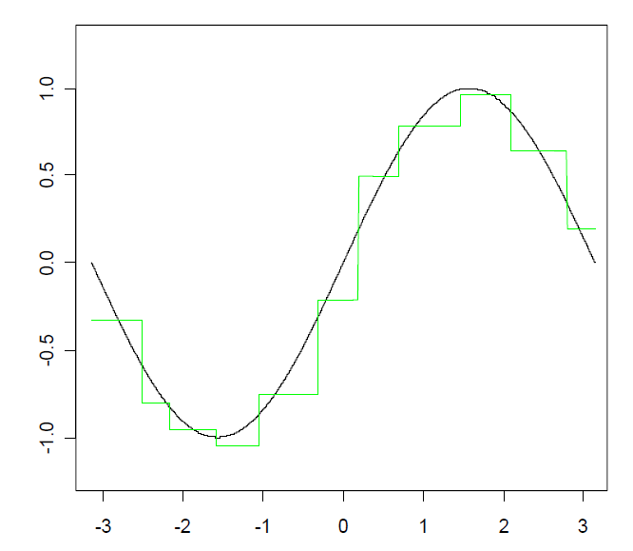
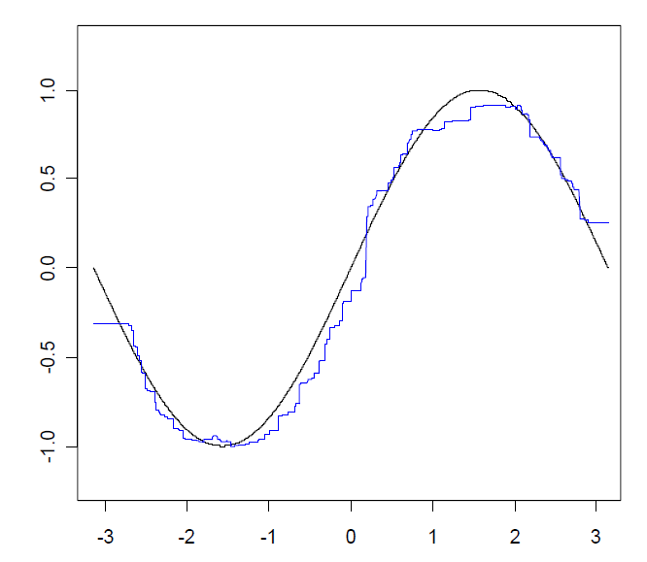
Case Study: Surviving the Titanic How Random Forest works
Titanic
Single Decision Tree
Random Forest

Slide 68
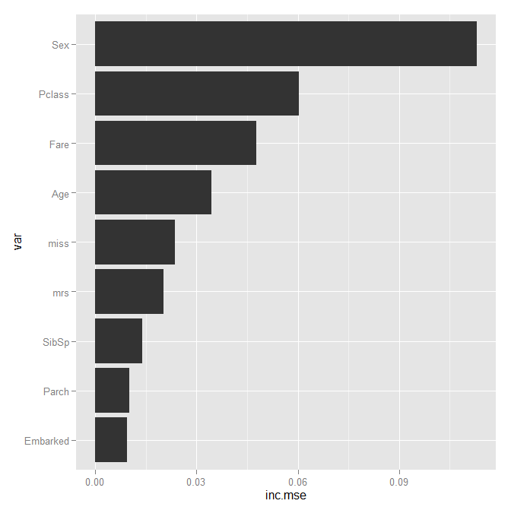
Case Study: Surviving the Titanic Random Forest can help us get a sense for which variables are predictive
Titanic
Using Random Forest to determine variable importance
fit.rf <- randomForest(
Survived ~ .,
data = titanic[,c("Survived", "Pclass",
"Sex", "Embarked", "SibSp", "Parch",
"Age", "Fare", "miss", "mrs")],
ntree = 500, proximity = FALSE,
keep.forest = TRUE, importance = TRUE)
imp.ratings <- data.frame(
var = rownames(fit.rf$importance),
inc.mse = fit.rf$importance[,1],
stringsAsFactors = FALSE)
imp.ratings <- arrange(imp.ratings, inc.mse)
imp.ratings$var <- factor(
imp.ratings$var,
levels = imp.ratings$var, ordered = TRUE)
windows()
ggplot(imp.ratings) +
geom_bar(aes(x = var, y = inc.mse)) +
coord_flip()
Age also very important

Slide 69
Case Study: Surviving the Titanic Thinking about data in terms of frequent item sets is also useful; this is the basis for the apriori algorithm which makes association rules in transactional data
Titanic
If I buy milk, what else am I likely to buy at the grocery store?
Beer → Bread
Beer → Milk
Milk → Beer
Jelly → Bread;
Milk → Bread
Bread → Peanut Butter
Penaut Butter → Bread
Milk → Peanut Butter
Jelly → Peanut Butter
(Jelly, Peanut Butter) → Bread
Jelly → (Bread, Peanut Butter)
(Bread, Jelly) → Peanut Butter
(Milk, Peanut Butter) → Bread
(Bread, Peanut Butter)
(Bread, Milk) → Peanut Butter

Slide 70
Case Study: Surviving the Titanic All variables must be converted into “factors” for apriori
Titanic
Preparing our dataset for apriori
trans <- titanic[,c("Survived", "Pclass", "Sex", "Embarked", "SibSp", "Parch", "Age", "Fare", "miss", "mrs")]
trans$Age <- cut(trans$Age, quantile(trans$Age, probs = c(0, 0.1, 0.9, 1)),
include.lowest = TRUE, labels = FALSE)
trans$Fare <- cut(trans$Fare, quantile(trans$Fare, probs = c(0, 0.1, 0.9, 1)),
include.lowest = TRUE, labels = FALSE)
trans <- mutate(trans,
Survived = ifelse(Survived == 1, "Yes", "No"),
SibSp = ifelse(SibSp > 0, "Yes", "No"),
Parch = ifelse(Parch > 0, "Yes", "No"),
Age = ifelse(Age == 1, "Child", ifelse(Age == 2, "Adult", "Elderly")),
Fare = ifelse(Fare == 1, "Super Saver", ifelse(Fare == 2, "Economy", "Delux")),
miss = ifelse(miss == 1, "Yes", "No"),
mrs = ifelse(mrs == 1, "Yes", "No"))
trans <- as.data.frame(apply(trans, 2, as.factor))

Slide 71
Case Study: Surviving the Titanic Run apriori to find some association rules related to survival specifically
Titanic
Running apriori
rules <- apriori(trans, parameter = list(minlen = 2, support = 0.05, confidence = 0.8),
appearance = list(rhs = c("Survived=No", "Survived=Yes"), default = "lhs"),
control = list(verbose = TRUE))
inspect(head(rules)) # 829 rules though!
lhs rhs support confidence lift
1 {Fare=Super Saver} => {Survived=No} 0.08866442 0.8586957 1.393621
2 {Sex=male} => {Survived=No} 0.52525253 0.8110919 1.316362
3 {Sex=female,
Fare=Delux} => {Survived=Yes} 0.06060606 0.9642857 2.512218
4 {Sex=male,
Age=Elderly} => {Survived=No} 0.05499439 0.8032787 1.303682
5 {Pclass=3,
Fare=Super Saver} => {Survived=No} 0.07519641 0.8375000 1.359221
6 {Sex=male,
Fare=Super Saver} => {Survived=No} 0.08641975 0.9277108 1.505629

Slide 72
Case Study: Surviving the Titanic Run apriori to find some association rules related to survival specifically
Titanic
Pruning apriori rules
# some appear to be redundant; toss em
subset.matrix <- is.subset(rules, rules)
subset.matrix[lower.tri(subset.matrix, diag = TRUE)] <- NA
redundant <- apply(subset.matrix, 2, sum, na.rm = TRUE) > 0
rules.pruned <- rules[!redundant] # 16 rules left; that's more like it
inspect(head(rules.pruned))

Slide 73
Case Study: Surviving the Titanic Run apriori to find some association rules related to survival specifically
Titanic
Final association rules
lhs rhs support confidence lift
1 {Fare=Super Saver} => {Survived=No} 0.08866442 0.8586957 1.393621
2 {Sex=male} => {Survived=No} 0.52525253 0.8110919 1.316362
3 {Sex=female,
Fare=Delux} => {Survived=Yes} 0.06060606 0.9642857 2.512218
4 {Parch=No,
mrs=Yes} => {Survived=Yes} 0.06958474 0.8493151 2.212689
5 {Sex=female,
Embarked=C} => {Survived=Yes} 0.07182941 0.8767123 2.284066
6 {Pclass=2,
Sex=female} => {Survived=Yes} 0.07856341 0.9210526 2.399584
7 {Pclass=1,
Sex=female} => {Survived=Yes} 0.10213244 0.9680851 2.522116
8 {Sex=female,
miss=No} => {Survived=Yes} 0.11896745 0.8030303 2.092105
9 {Pclass=3,
Embarked=S} => {Survived=No} 0.32098765 0.8101983 1.314912
10 {Pclass=3,
miss=No} => {Survived=No} 0.36026936 0.8251928 1.339247
11 {miss=No,
mrs=No} => {Survived=No} 0.52525253 0.8041237 1.305053
12 {Pclass=3,
Age=Adult,
mrs=No} => {Survived=No} 0.33333333 0.8070652 1.309827
13 {Embarked=S,
SibSp=Yes,
Parch=No,
mrs=No} => {Survived=No} 0.05274972 0.8103448 1.315150
lhs rhs support confidence lift
14 {Embarked=S,
SibSp=Yes,
Age=Adult,
mrs=No} => {Survived=No} 0.08080808 0.8275862 1.343132
15 {Embarked=S,
SibSp=No,
Parch=No,
miss=No} => {Survived=No} 0.30864198 0.8136095 1.320448
16 {SibSp=No,
Parch=No,
Age=Adult,
miss=No} => {Survived=No} 0.34118967 0.8000000 1.298361
Cool, but can we look at this visually?

Slide 74
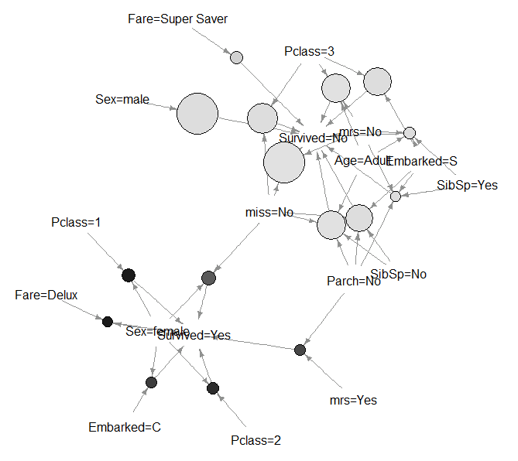
Case Study: Surviving the Titanic Run apriori to find some association rules related to survival specifically
Titanic
Size = support (% population)
Color = lift (predictive certainty)

